Slide 1
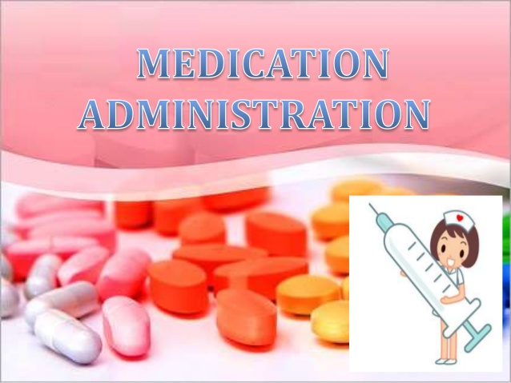
Fundamentals of Nursing (1st Stage)
Medication administration
Lecture 1
By
Assistant. Lecturer. Khadija Mohammed Jassim
Fundamentals of Nursing Department
College of Nursing
University of Basrah
University of Basrah –College of Nursing – Fundamentals of Nursing Department

Slide 2
Objectives
1- To recognize basic information about drugs & routs of medication administration.
2- To understand indications & effects of drugs.
University of Basrah –College of Nursing– Fundamentals of Nursing Department
2

Slide 3
Introduction
A medication: is a substance administered for the diagnosis, cure, treatment, or relief of a symptom or for prevention of disease.
A drug: is any substance that alerts physiologic function , with the potential of affecting health.
The nurse administering medications needs to have a knowledge base about drugs, including drug names, preparations, classifications, adverse effects, and physiologic factors that affect drug action.
University of Basrah –College of Nursing– Fundamentals of Nursing Department
3

Slide 4
Indications
Drugs can be administered for these purposes:
1- Diagnostic purpose: (e.g. assessment of liver function)
2- prophylaxis: (e.g. heparin to prevent thrombosis, antibiotic to prevent infection)
3- Therapeutic purpose: (e.g. replacement of fluid or vitamins).
4- supportive purpose: ( to enable other treatment such as anesthesia) .
University of Basrah –College of Nursing– Fundamentals of Nursing Department
4

Slide 5
Names
The chemical name: is a precise description of the drug’s chemical composition.
The generic name: which identifies the drug’s active ingredient, is the name assigned by the manufacturer that first develops the drug.
The trade name: also referred to as the brand name or proprietary name, is selected by the pharmaceutical company that sells the drug and is protected by trademark.
University of Basrah –College of Nursing– Fundamentals of Nursing Department
5

Slide 6
Legislation and standards
Federal regulation.
State and local regulation.
Health care institutions and medication laws.
Nursing practice.
University of Basrah –College of Nursing– Fundamentals of Nursing Department
6

Slide 7
Common Types Of Drug Preparations
Description | Preparation
A solid form, shaped like a capsule, coated and easily swallowed | Caplet
Powder or gel form of an active drug enclosed in a gelatinous container | Capsule
Medication in a clear liquid containing water, alcohol, sweeteners | Elixir
Drug particles in a solution for topical use | Lotion
Single or mixture of finely ground drugs | Powder
Medication combined in a water and sugar solution | Syrup
A powdered drug compressed into a hard small disk; some are readily broken along a scored line; others are enteric coated to prevent them from dissolving in the stomach | Tablet
University of Basrah –College of Nursing– Fundamentals of Nursing Department
7

Slide 8
Mechanisms of Drug Action
Pharmacokinetics: is the effect of the body on the drug, once the drug enters the body. It is the movement of drug molecules in the body in relation to the drug’s absorption, distribution, metabolism, and excretion.
Route how enter the body.
Absorption from site into blood.
Distribution from blood into cells, tissue or organs.
Action how a medication acts.
Metabolism changed to prepare for excretion.
Excretion how they exist the body.
University of Basrah –College of Nursing– Fundamentals of Nursing Department
8

Slide 9
Effects of drugs
Therapeutic effect : is the desired outcome in medication administration.
Allergic Effect: is an immune system response that occurs when the body interprets the administered drug as a foreign substance and forms antibodies against the drug.
Secondary effect: effect that is not intended may be harmful.
Adverse effect : more serious side effects or a reaction to the drug .
Drug toxicity: related to overdose , ingestion when meant to the external in use or build up in blood.
Anaphylactic reaction: sever allergy to drug that could become fatal.
University of Basrah –College of Nursing– Fundamentals of Nursing Department
9

Slide 10
Factors Affecting Drug Action
Developmental Considerations.
Weight.
Gender.
Cultural and Genetic Factors.
Psychological Factors.
Pathology.
Environment.
Timing of Administration.
University of Basrah –College of Nursing– Fundamentals of Nursing Department
10

Slide 11
Routes Of Administration
The route of administration (ROA) that is chosen may have a profound effect upon the speed and efficiency with which the drug acts.
The possible routes of drug entry into the body may be divided into two classes:
Enteral .
Parenteral .
1.Enteral Routes :
drug placed directly in the GI tract:
University of Basrah –College of Nursing– Fundamentals of Nursing Department
11

Slide 12
1- Oral
Oral administration is the most common, least expensive, and most convenient route for most clients.
Advantages:
Convenient (can be self administered , pain free, easy to take).
Usually least expensive
Absorption takes place along the whole length of the GI tract.
University of Basrah –College of Nursing– Fundamentals of Nursing Department
12

Slide 13
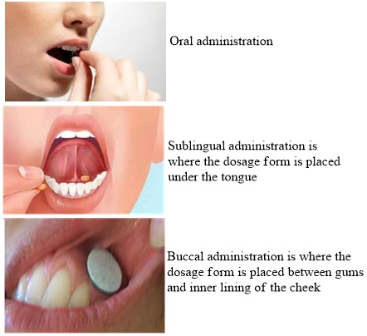
Disadvantages
Inappropriate for clients with nausea or vomiting.
Drug may have unpleasant taste or odor.
Inappropriate if client cannot swallow or is unconscious.
Drug may discolor teeth.
Drug may irritate gastric mucosa.
University of Basrah –College of Nursing– Fundamentals of Nursing Department
13

Slide 14
2- Sublingual/ Buccal
administration a drug is placed under the tongue, where it dissolves.
Advantages:
Drug can be administered for local effect.
More potent than oral route because drug directly enters the blood and bypasses the liver.
Disadvantages:
Drug is rapidly absorbed into the bloodstream.
If swallowed, drug may be inactivated by gastric juice.
University of Basrah –College of Nursing– Fundamentals of Nursing Department
14

Slide 15
3- Rectal
Unconscious patients and children.
If patient is nausea or vomiting .
Easy to terminate exposure.
Absorption may be variable.
Good for drugs affecting the bowel such as laxatives.
University of Basrah –College of Nursing– Fundamentals of Nursing Department
15

Slide 16
2- Parenteral Routes:
Parenteral administration of medications is a common nursing procedure. Nurses give parenteral medications intradermally (ID), subcutaneously, intramuscularly (IM), or intravenously (IV). Because these medications are absorbed more quickly than oral medications.
University of Basrah –College of Nursing– Fundamentals of Nursing Department
16

Slide 17
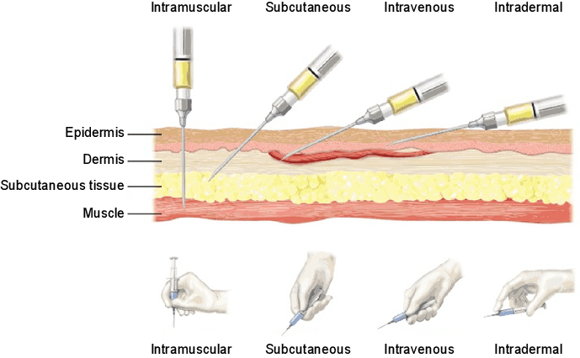
Parenteral Routes:
Subcutaneous (hypodermic)—into the subcutaneous tissue, just below the skin.
Intramuscular (IM)—into a muscle.
Intradermal (ID)—under the epidermis (into the dermis).
Intravenous (IV)—into a vein.
Inhalation --- absorption through the lung.
University of Basrah –College of Nursing– Fundamentals of Nursing Department
17

Slide 18
1- Intravenous (IV):
Absorption phase is bypassed:
Precise, accurate and almost immediate onset of action.
Large quantities can be given, fairly pain free.
Greater risk of adverse effects.
High concentration attained rapidly.
Risk of embolism.
University of Basrah –College of Nursing– Fundamentals of Nursing Department
18

Slide 19
2- Intramuscular (IM):
Very rapid absorption of drugs in aqueous solution.
Repository and slow release preparation.
Pain at injection sites for certain drugs.
3- Subcutaneous (SC):
Slow and constant absorption.
Absorption is limited by blood flow, affected if circulatory problems exist.
Concurrent administration of vasoconstrictor will slow absorption.
University of Basrah –College of Nursing– Fundamentals of Nursing Department
19

Slide 20
4- Inhalation:
Gaseous and volatile agents and aerosols.
Rapid onset of action due to rapid access to circulation:
Large surface area.
Thin membranes separates alveoli from circulation.
High blood flow.
University of Basrah –College of Nursing– Fundamentals of Nursing Department
20

Slide 21
Topical :
Mucosal membranes : (eye drops, antiseptic, sunscreen, nasal,..).
Skin:
Dermal : rubbing in of oil or ointment ( local action).
Transdermal : absorption of drug through skin ( systemic action):
Stable blood levels.
Not first pass metabolism.
Drug must be potent or patch becomes to large.
University of Basrah –College of Nursing– Fundamentals of Nursing Department
21

Slide 22
Times until drugs effects
Intravenous: ( 30-60 seconds).
Inhalation : ( 2-3 minutes).
Sublingual : (3-5 minutes).
Intramuscular : (10-20 minutes).
Subcutaneous : (15-30 minutes).
Rectal: (5-30 minutes).
Ingestion : (30-90 minutes).
Transdermal (topical): (minutes to hours).
University of Basrah –College of Nursing– Fundamentals of Nursing Department
22

Slide 23
Parts of the Medication Order
The medication order consists of seven parts:
1. Patient’s name
2. Date and time the order is written
3. Name of drug to be administered
4. Dosage of the drug
5. Route by which the drug is to be administered
6. Frequency of administration of the drug
7. Signature of person writing the order
University of Basrah –College of Nursing– Fundamentals of Nursing Department
23

Slide 24
Right of medication administration safety
Six right:
Right drug.
Right patient.
Right dose.
Right time.
Right route.
Right documentation.
University of Basrah –College of Nursing– Fundamentals of Nursing Department
24

Slide 25
Methods of Calculating Dosages
Basic Formula
The basic formula for calculating drug dosages is commonly used and easy to remember:
D = desired dose (i.e., dose ordered by primary care provider)
H = dose on hand (i.e., dose on label of bottle, vial, ampule)
V = vehicle (i.e., form in which the drug comes, such as tablet or liquid).
Formula = D * V / H = amount to administer
University of Basrah –College of Nursing– Fundamentals of Nursing Department
25

Slide 26
Converting ratio proportion
1 kg = 1000 gm
1 gm = 1000 mg
1 mg = 1000 mcg
1L = 1000 ml
1 oz = 30 ml
1 stp = 5 ml
1 grain = 60 mg
University of Basrah –College of Nursing– Fundamentals of Nursing Department
26

Slide 27
Example (1):
Order: Erythromycin 500 mg
On hand: 250 mg in 5 mL
D = 500 mg H = 250 mg V = 5 mL
Formula = D * V / H = amount to administer
500 mg
250 mg * 5 mL =
2,500
250 = 10 mL
University of Basrah –College of Nursing– Fundamentals of Nursing Department
27

Slide 28
Example (2):
Order: Aspirin 10 gr
On hand: Aspirin 325 mg tablets
1 gr = 60 mg
10 gr = 600 mg
H = 325 mg V = 1 tablet D = 600 mg x
Formula = D * V / H = amount to administer
600*1/325 = 1.8 = 2 tablets
University of Basrah –College of Nursing– Fundamentals of Nursing Department
28

Slide 29
University of Basrah –College of Nursing– Fundamentals of Nursing Department
29

